Slide 1


TE Project Based Seminar
on
Study of Different Deep Learning Models used in Stock Price Prediction
Students name Harshali Bedmutha
Roll No 306006
Guides name Dr. Mrs. Himangi Pande

Slide 2
AGENDA
Introduction to Stock Market
Deep Learning
Literature Survey
Method 1
-Data
-Model
-Process
-Result
Method 2
- Methodology
- Result
Conclusion

Slide 3
Introduction
A stock market, equity market or share market is the aggregation of buyers and sellers of stocks (also called shares), which represent ownership claims on businesses; these may include securities listed on a public stock exchange as well as those only traded privately.
Stock market prediction is the act of trying to determine the future value of a company stock or other financial instrument traded on an exchange.
The successful prediction of a stock's future price could yield significant profit.

Slide 4
Introduction to Deep Learning
Deep Learning is a subfield of machine learning concerned with algorithms inspired by the structure and function of the brain called artificial neural networks
Learning can be supervised or unsupervised.
Deep Learning Architectures : Deep Neural Network, Deep Belief Networks, Recurrent Neural Networks etc.
Applications: Computer vision, speech recognition, natural language processing, audio recognition, social network filtering etc.

Slide 5
Literature Review
Sr. no | Title | Description | Results
1 | Sreelekshmy Selvin, Vinayakumar R, Gopalakrishnan E.A, Vijay Krishna Menon, ‘STOCK PRICE PREDICTION USING LSTM,RNN AND CNN-SLIDING WINDOW MODEL’, International Conference on Advances in Computing, Communications and Informatics (ICACCI),IEEE, Udupi, India, Sept 2017 | Time series analysis of stock data using LSTM, RNN and CNN for two different sectors(IT and Pharma sector) Use of a Sliding Window Approach Prediction made for next 10 minutes Comparison between the methods used (RNN,CNN LSTM) | CNN is proved to be the best in proposed method. CNN uses information given at particular instance for prediction and hence it outperforms the other algorithms.
2 | David M. Q. Nelson, Adriano C. M. Pereira, Renato A. de Oliveira, ‘Stock Market’s Price Movement Prediction With LSTM Neural Networks’, International Joint Conference on Neural Networks (IJCNN),IEEE, Anchorage, AK, USA,May 2017 | Long Short Term Memory (LSTM) is used to build a prediction system that predicts a particular stock will go up in next 15 minutes or not. Kruskal-Wallis algorithm is used for testing | The model has a p value less than 0.05 The model outperforms random forest model

Slide 6
Sr. no | Title | Technique | Results
3 | Kai Chen ,Yi Jhou, Fangyan Dai , ‘A LSTM-based method for stock returns prediction : A case study of China stock market’ , IEEE International Conference on Big Data (Big Data), IEEE , Santa Clara, CA, USA, Nov 2015 | A single input layer, multiple LSTM layers , a dense layer and Single output layer is used. | Accuracy increased form 14.3% of existing systems to 27.2% of the proposed method. Results revealed that normalization was very useful for improving accuracy
4 | M. Ugur Gudelek ,S. Arda Boluk, A. Murat Ozbayoglu ,’A Deep Learning based Stock Trading Model with 2-D CNN Trend Detection’ , IEEE Symposium Series on Computational Intelligence (SSCI), IEEE, Honolulu, HI, USA ,Nov 2017 | Uses Exchange Traded Fund(ETF) as a factor to eliminate volatility and hence increase accuracy A virtual paper trading system is simulated where we buy and sell stocks to demonstrate that the method outperforms | Accuracy 70% High precision, recall and accuracy and significantly outperforms Buy and Hold strategy.

Slide 7
STOCK PRICE PREDICTION USING LSTM,RNN AND CNN-SLIDING WINDOW MODEL [1]

Slide 8
Architecture Diagram
DATA
MODEL
PROCESSING
ERROR
CALCULATION
Fig:1 [1]

Slide 9
Dataset
The data set consists of minute wise stock price for 1721 NSE listed companies for the period of July 2014 to June 2015.
It includes informations like day stamp, time stamp, transaction id, stock price and volume of stock sold in each minute.
Two different sectors, IT sector and Pharma sector.
The data for these three companies were extracted from the available data and was subjected to preprocessing to obtain the stock price.

Slide 10
MODEL
[1] uses a sliding window approach.
Find the best window length by calculating the errors
Data was subjected to Normalization and was mapped to a range of 0 to 1.
This normalized data was given to the network for training for 1000 epochs
If the loss (mean squared error) for the current epoch is less than the value obtained in previous epoch, the weight matrices for that epoch is stored.
Testing(least Root Mean Square Error )

Slide 11

PROCESSING
[1] uses three different deep learning architectures-
a. Recurrent Neural Network(RNN)
b. Long Short Term Memory (LSTM)
c. Convolutional Neural Network(CNN).
Recurrent Neural Network is a class of neural network where connections between the computational units form a directed circle.
Fig:2 [5]

Slide 12
Long Short Term Memory(LSTM) is a special kind of RNN. The cells are composed of various gates that can control the input ﬂow.
An LSTM cell consists of input gate, cell state, forget gate, and output gate. It also consists of sigmoid layer, tanh layer and point wise multiplication operation.
The cell state is updated based on the outputs form the gates.

Slide 13
Input gate : Input gate consists of the input.
Cell State : Runs through the entire network and has the ability to add or remove information with the help of gates.
Forget gate layer: Decides the fraction of the information to be allowed.
Output gate : It consists of the output generated by the LSTM.
Sigmoid layer generates numbers between zero and one, describing how much of each component should be let through.
Tanh layer generates a new vector, which will be added to the state.

Slide 14
Mathematically
ft = σ(Wf.[ht−1,xt] + bf)
it = σ(Wi.[ht−1,xt] + bi)
ct = tanh(Wc.[ht−1,xt] + bc)
ot = σ(Wo[ht−1,xt] + bo)
ht = ot ∗tanh(ct)
Where,
xt: input vector ht: output vector ct: cell state vector
ft: forget gate vector it: input gate vector ot: output gate vector
and W, b are the parameter matrix and vector

Slide 15

Fig:3 [5]

Slide 16
Convolutional Neural Network architectures mainly focuses on the given input sequence and does not use any previous history or information during the learning process.
The motivation behind testing the models with data from other companies is to check for interdependencies among the companies and to understand the market dynamics.
The error percentage was calculated using
ep = abs[ Xi(real) −Xi(predicted) ] * 100
Xi(real)

Slide 17
RESULTS
From the table it is clear that CNN is giving more accurate results than the other two models.
This is due to the reason that CNN does not depend on any previous information for prediction. It uses only the current window for prediction.
TABLE I : ERROR PERCENTAGE [1]
Company | RNN | LSTM | CNN
Infosys | 3.90 | 4.18 | 2.36
TCS | 7.65 | 7.82 | 8.96
Cipla | 3.83 | 3.94 | 3.63

Slide 18
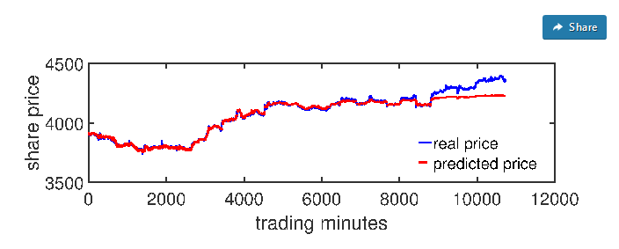
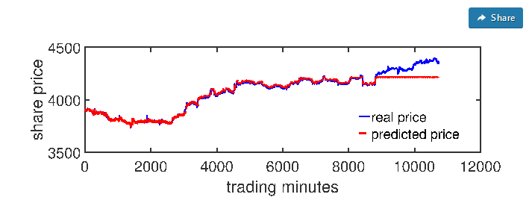
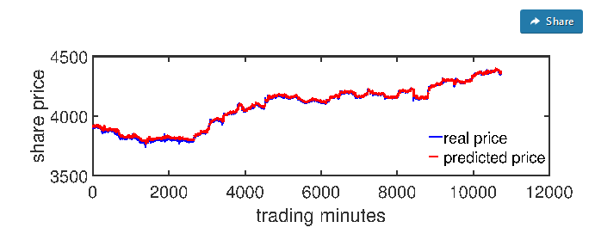
Fig. 5: Plot for Real value vs Predicted value for INFOSYS using LSTM [1]
Fig. 4: Plot for Real value vs Predicted value for INFOSYS using RNN [1]
Fig. 6: Plot for Real value vs Predicted value for INFOSYS using CNN [1]

Slide 19
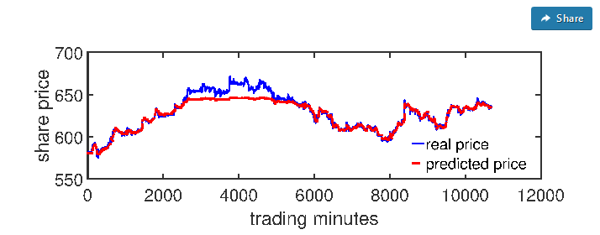
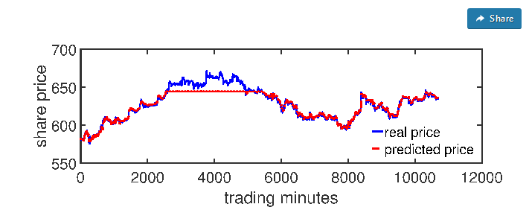
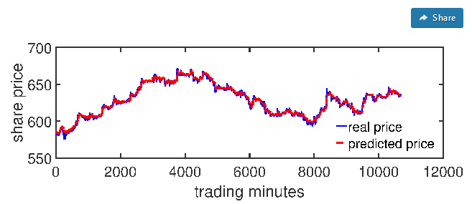
Fig. 7: Plot for Real value vs Predicted value for CIPLA using RNN [1]
Fig. 8: Plot for Real value vs Predicted value for CIPLA using LSTM [1]
Fig. 9: Plot for Real value vs Predicted value for CIPLA using CNN [1]

Slide 20
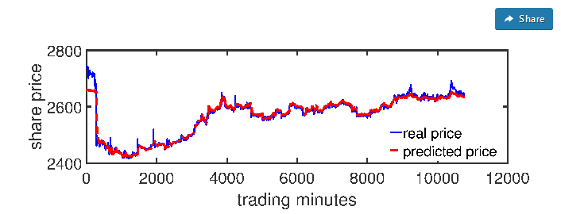
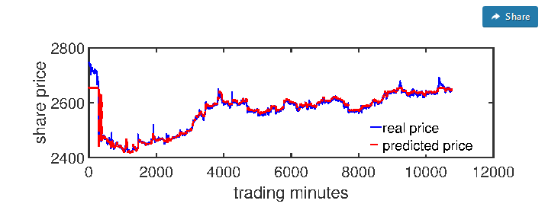
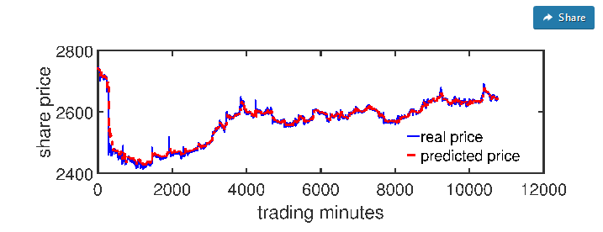
Fig. 10: Plot for Real value vs Predicted value for TCS using RNN [1]
Fig. 11: Plot for Real value vs Predicted value for TCS using LSTM [1]
Fig. 12: Plot for Real value vs Predicted value for TCS using CNN [1]

Slide 21
Inferences
For proposed methodology in [1] CNN is the most efficient algorithm for time series analysis of stock data
Even though the other two models are used in many other time dependent data analysis, it is not out performing the CNN architecture in this case.
This is due to sudden changes in stock market that CNN outperforms the rest of the algorithms

Slide 22
Deep Learning based Stock Trading Model with 2-D CNN Trend Detection [4]

Slide 23
METHODOLOGY
[4] propose a novel method for predicting stock price movements using CNN.
To avoid the high volatility of the market and to maximize the proﬁt, ETFs(Exchange Traded Funds) are used as primary ﬁnancial assets.
An ETF is a type of fund that owns the underlying assets (shares of stock, bonds, oil futures, gold bars, foreign currency, etc.) and divides ownership of those assets into shares.
In [4] a convolutional neural network is trained on the historical ﬁnancial data.
extracted some of the most commonly used fundamental analysis indicators and included them to the feature set

Slide 24
For technical analysis [4] uses relative strength index (RSI), simple moving average (SMA), the moving average convergence/divergence oscillator (MACD), the Williams percent range (Williams %R), the stochastic oscillator, the ultimate oscillator, the money ﬂow index (MFI).
In order to make price time series stationary, ﬁrst difference method is used.
Normalization with hyperbolic tangent function (tanh) (3b)
CNN consists of an input layer, several hidden layers and an output layer
Input layer is a representation of identity function, f(x)=x. Output layer which makes decisions, passes previously calculated weights through a linear function .
Hidden layers are either convolutional, pooling, dropout or fully connected.
Agglomerative clustering

Slide 25
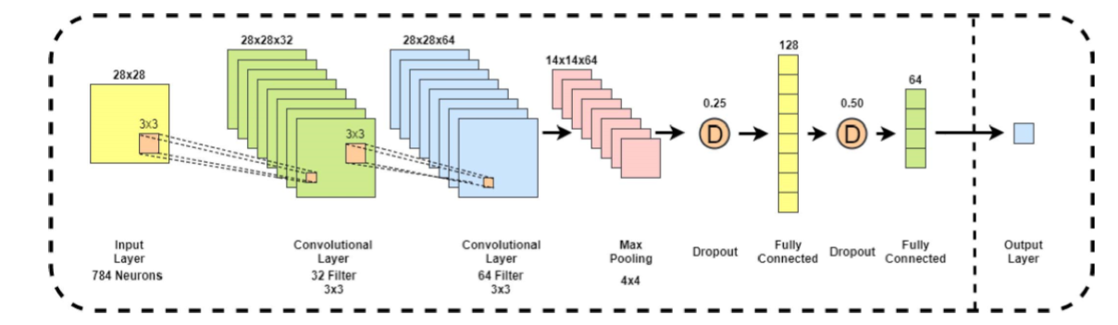
Fig : 11

Slide 26
RESULTS
The model is evaluated on both regression and classsification
For both classiﬁcation and regression tasks, the ratio of 0.9 was used as a training-test set ratio
In the test phase of the regression task, two schemes are adopted, namely 2-class and 3class regression.
In 2-class regression, values that are greater than 0 are considered as ”buy” signals and values that are less than or equal to 0 are considered as ”sell” signals.
In 3class regression, we set the values in the range [-1,-0.38] as ”sell” signals, values between (-0.38, 0.38] as ”hold” signals and values between (0.38, 1] as ”buy” signals.
In 2-class classiﬁcation, samples with target values that are less than 0 are considered as negative samples while the rest are considered as positive.
In 3-class classiﬁcation, the threshold values -0.38 and 0.38 are used to determine the classes.

Slide 27
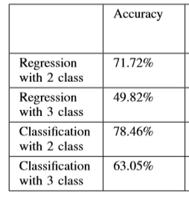
Table II: Accuracy
Accuracy results of 2-class regression and 2-class classiﬁcation are relatively close as expected because targets of the regression model are mapped between [-1,1] similar to the probability values and evaluated as a classiﬁcation model regarding the accuracy metric.
Difference between the accuracy results of 2-class and 3class models is considerably large, both for regression and classiﬁcation models.
This shows that it is more difﬁcult for the model to distinguish the cases where it should hold and the cases where it should buy or sell than the cases where it should distinguish between buying and selling.
This is caused by the volatility of the prices.

Slide 28
CONCLUSION
We studied Different Deep Learning Approaches used in Stock Price Prediction.
Recurrent Neural Network, Convolutional Neural Networks and Long Short Term Memory are three methods the seminar was focussed on.
Amongst the three methods according to [1] CNN outperforms.
Though CNN is generally used in the context of images it is being explored for stock price prediction too.

Slide 29
References
[1] Sreelekshmy Selvin, Vinayakumar R, Gopalakrishnan E.A, Vijay Krishna Menon, ‘STOCK PRICE PREDICTION USING LSTM,RNN AND CNN-SLIDING WINDOW MODEL’, International Conference on Advances in Computing, Communications and Informatics (ICACCI),IEEE, Udupi, India, Sept 2017
[2] Kai Chen ,Yi Jhou, Fangyan Dai , ‘A LSTM-based method for stock returns prediction : A case study of China stock market’ , IEEE International Conference on Big Data (Big Data), IEEE , Santa Clara, CA, USA, Nov 2015
[3] David M. Q. Nelson, Adriano C. M. Pereira, Renato A. de Oliveira, ‘Stock Market’s Price Movement Prediction With LSTM Neural Networks’, International Joint Conference on Neural Networks (IJCNN),IEEE, Anchorage, AK, USA,May 2017
[4] M. Ugur Gudelek ,S. Arda Boluk, A. Murat Ozbayoglu ,’A Deep Learning based Stock Trading Model with 2-D CNN Trend Detection’ , IEEE Symposium Series on Computational Intelligence (SSCI), IEEE, Honolulu, HI, USA ,Nov 2017

Slide 30
References
[5] colah.github.io/posts/2015-08-Understanding-LSTMs/
[6]https://www.semanticscholar.org/paper/Stock-price-prediction-using-LSTM%2C-RNN-and-window-Selvin-Vinayakumar/64ca5f3e4fa2d33ae860bebaea81420fae0759af
[7]https://en.wikipedia.org/wiki/Stock_market
[8] http://faganasset.com/2015/04/16/if-not-the-stock-market-then-where/
[9] cs231n.github.io/convolutional-networks/
[10] deeplearning4j.org

